Slide 1
The Church-Turing Thesis

Slide 2
Turing Machines
A Turing machine is similar to a finite automaton with a supply of unlimited memory.
A Turing machine can do everything that any computing device can do.
A TM is a theoretical machine, can be implemented by a computer
There exist problems that even a Turing machine cannot solve.

Slide 3
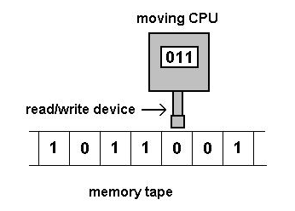
A Turing Machine Image

Slide 4
Formal definition
A Turing machine is a 7-tuple M = (Q, Σ, Γ, δ, q₀, q_{accpt}, q_{reject}) where Q, Σ, Γ are finite sets and
1. Q is a set of states
2. Σ is the input alphabet and ⊔ ∉ Σ (⊔ represent empty)
3. Γ is the tape alphabet, ⊔ ∈ Γ, Σ ⊂ Γ
4. δ : Q × Γ → Q × Γ × {L,R} is the transition function
5. q₀ ∈ Q is the initial state
6. q_{accept} ∈ Q is the accept state (sometimes denoted q_{a})
7. q_{reject} ∈ Q is the reject state (sometimes denoted q_{r})
Note: q_{reject} is optional in the definition.

Slide 5
Computations
M = (Q, Σ, Γ, δ, q₀, q_{accpt}, q_{reject}) computes as follows:
M receives as input w = a₁a₂ . . . a_{n} ∈ Σ* , a_{i} ∈ Σ , written on the leftmost squares of the tape and the rest of the tape is blank (i.e., filled with ⊔)
The head starts on the leftmost square of the tape.
The first blank encountered shows the end of the input.
Once it starts, it proceeds by the rules defined by δ.
If M ever tries to move off to the left of the leftmost square the head stays in the leftmost square even though δ indicate L.
The computation continues until M is either in q_{accept}, or q_{reject}; if M enters q_{accept}, the input string is accepted.
M may go on forever.

Slide 6
A TM Example
Checking if a binary integer is even
Q = {s, e, o, r, a}
Σ = {0, 1}
Γ = {0, 1, #, B}
δ ➔➔
State | R | W | L/R | New State
s | 0 | # | R | e
s | 1 | # | R | o
e | 0 | # | R | e
e | 1 | # | R | o
o | 0 | # | R | e
o | 1 | # | R | o
s | B | # | R | r
e | B | # | R | a
o | B | # | R | r

Slide 7
Another TM Example
Checking if a binary integer is ???
Q = {s, t, r, a}
Σ = {0, 1, e, o}
Γ = {0, 1,e, o, #, B}
δ ➔➔
State | R | W | L/R | New State
s | 0 | e | R | s
s | 1 | o | R | s
s | B | # | L | t
t | e | e | R | a
t | o | o | R | r

Slide 8
The TM’s state diagram
a
0 →e, R
1 →o, R
e→ e, R
s
t
r
B → #, L
o → o, R
State | R | W | L/R | New State
s | 0 | e | R | s
s | 1 | o | R | s
s | B | # | L | t
t | e | e | R | a
t | o | o | R | r

Slide 9
Yet Another TM Example
Checking if a binary integer is ???
Q = {s, t, r, a}
Σ = {0, 1 }
Γ = {0, 1, B}
δ ➔➔
State | R | W | L/R | New State
s | 0 | 0 | R | s
s | 1 | 1 | R | s
s | B | B | L | t
t | 0 | 0 | R | a
t | 1 | 1 | R | r

Slide 10
Configuration
A configuration C of M is the current state, current tape content and the current R/W head position
It is a tuple C = <u, q, v>, where q ∈ Q, uv ∈ Γ is the tape content and the head is pointing to the first symbol of v.
Configurations are used to formalize machine computation and therefore are represented by special symbols.
Tape contains only ⊔ following the last symbol of v.

Slide 11
Formalizing TM computation
A configuration C₁ yields a configuration C₂ if the TM can legally go from C₁ to C₂ in a single computation step
Formally: suppose a, b, c ∈ Γ, u, v ∈ Γ* and q_{i}, q_{j} ∈ Q.
1. We say that ua q_{i} bv yields uac q_{j} v if δ(q_{i}, b) = (q_{j}, c,R); (machine moves rightward)
2. We say that ua q_{i} bv yields u q_{j} acv if δ(q_{i}, b) = (q_{j}, c,L); (machine moves leftward)

Slide 12
Head at one input end
Given M = (Q, Σ, Γ, δ, q₀, q_{accpt}, q_{reject})
For the left-hand end:
the configuration q_{i} bv yields q_{j} cv if the transition is left moving, i.e., δ(q_{i}, b) = (q_{j}, c, L)
the configuration q_{i} bv yields c q_{j} v for the right moving transition, i.e., δ(q_{i}, b) = (q_{j}, c,R)
For the right-hand end:
the configuration ua q_{i} is equivalent to ua q_{i}⊔ because we assume that blanks follow the part of the tape represented in configuration. Hence, we can handle this case as the previous one

Slide 13

Book Example 2
M₂ is a TM that decides A = { | n ≥ 0}.
Basically M₂="On input string w
Sweep left to right across the tape, crossing off every other 0;
If in stage 1 the tape contained a single 0, accept.
Return the head to the left-hand end of the tape.
Go to stage 1.”

Slide 14
Example 2 explained
1. Sweep left to right across the tape, crossing off every other 0; if the number of 0s is odd, reject;
(a) Mark the first 0 by ⊔: δ(q₁, 0) = <q2, ⊔,R>
(b) Cross off the next 0 after ⊔: δ(q₂, 0) = <q3, x, R>
(c) Pass 0 at odd position; cross off 0 at even position.
δ(q₃, 0) = <q₄, 0,R>, δ(q₄, 0) =<q₃, x, R>, δ(q, x) = <q, x, R> for
q ∈ {q2, q3, q4}.
(d) If the number of 0 is odd, reject: (δ(q₄, ⊔) = <q_{r}, ⊔,R>)
2. If in stage 1 the tape contained a single 0, accept: δ(q₂, ⊔) = <q_{a}, ⊔,R>
3. Return the head to the left-hand end of the tape: δ(q₃, ⊔) = <q₅, ⊔,L>, δ(q₅, a) = <q₅, a,L> for a ∈ {0, x}.
4. Go to stage 1 (b): δ(q₅, ⊔) = <q2, ⊔,R>.

Slide 15
Basic principle and more examples
Checking if zeros form a complete binary tree + 1
Example “0”
q₁0 ⊔ → ⊔q₂⊔ → ⊔⊔q_{a}
Example “00”
q₁00 ⊔ → ⊔q₂0⊔ → ⊔xq₃⊔ → ⊔q₅x⊔ → q₅⊔x⊔ → ⊔q₂x⊔ → ⊔xq₂⊔ → ⊔x⊔q_{a}
Example “000”
q₁000 ⊔ → ⊔q₂00⊔ → ⊔xq₃0⊔ → ⊔x0q₄⊔ → ⊔x0⊔q_{r}
See book page 144 for 0000

Slide 16
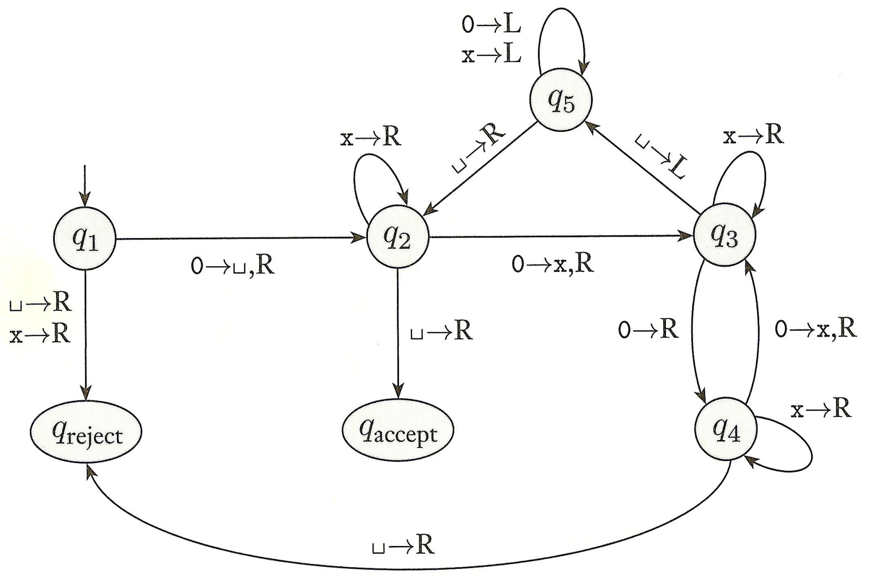
The State Diagram of M₂ Fig 3.8
In q₁ with the head reading 0, the machine goes to q₂, writes ⊔ and move the head to the right, that is
δ(q₁, 0) = (q₂, ⊔, R)
Short for 0 → 0, R

Slide 17
What is a TM, then
Each TM is basically an algorithm
Or
Each TM is a special machine that solves one specific problem

Slide 18
Example TM computation
Construct a TM M₁ that tests the membership in the language L1 = {w#w | w ∈ {0, 1}}
s₀: if first symbol is 0 or 1, replace it by x, remember it as a; if it is #, go to s₅; else reject;
s₁(a): move right until #; if no # before ⊔, reject;
s₂(a): move right until 0 or 1; if the current symbol is the same as a, then replace it by x; else reject;
s₃: move left until #;
s₄: move left until x and goto s₀;
s₅: move right until 0, 1, or ⊔; accept if ⊔; reject if 0, 1.

Slide 19
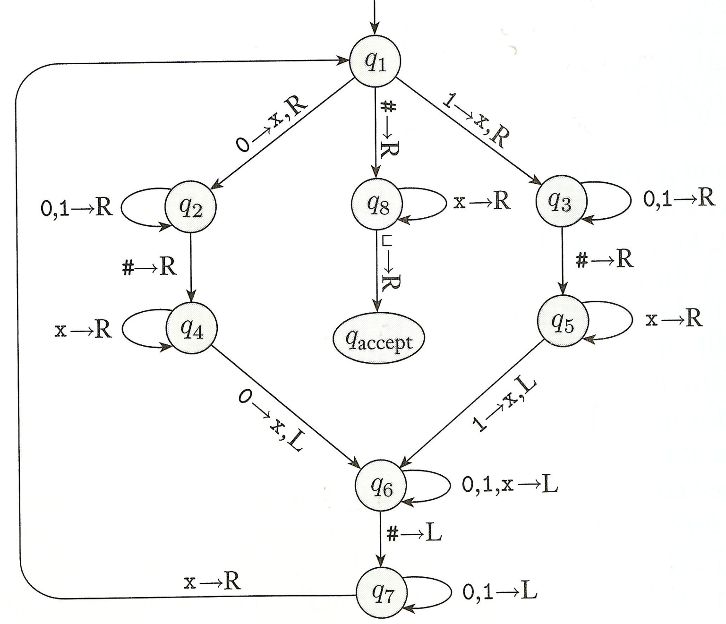
Another State diagram
Short for 0 → 0, R and 1 → 1, R

Slide 20
Accepting an input w
A Turing machine M accepts the input w if a sequence of
configurations C₁,C₂, . . . ,C_{n} exists such that:
1. C₁ is the starting configuration, C₁ = (ǫ, q₀,w)
2. Each C_{i} yields C_{i+1}, i = 1, 2, . . . , n − 1
3. C_{n} is an accepting configuration.

Slide 21
Language of M
L(M) = {w ∈ | M accepts w}
Turing-recognizable language: A language L is Turing-recognizable if there is a Turing machine M that recognizes it.

Slide 22
Outcomes of a TM
When we start a TM on an input w three cases can happen:
1. TM may accept w
2. TM may reject w
3. TM may loop indefinitely, i.e., TM does not halt.
Note: looping does not mean that machine repeats the same steps over and over again; looping may entail any simple or complex behavior that never leads to a halting state.
Sometimes it is difficult to distinguish a machine that fail to accept from one that merely takes long-time to halt.

Slide 23
Equivalence of TMs
To show that two models of TM are equivalent we need to show that we can simulate one by another.

Slide 24
Multitape Turing Machines
A multitape TM is like a standard TM with several tapes
Each tape has its own head for reading/writing
Initially the input is on tape 1 and other tapes are blank
Transition function allow for reading, writing, and
moving the heads on all tapes simultaneously, i.e.,
δ : Q × Γ ^{k} → Q × Γ ^{k} × {L,R}^{k}, where k is the number of
tapes.
δ(q_{i}, a₁, . . . , a_{k}) = (q_{j} , b₁, . . . , b_{k},L,R, . . . ,L) means that if
the machine is in state qi and heads 1 though k are reading symbols a₁ through a_{k} the machine goes to state q_{j} , writes b₁ through b_{k} on tapes 1 through k, respectively, and moves each head to the left or right as specified.

Slide 25
Theorem 3.13
Every multitape Turing machine has an equivalent single tape Turing machine.
Proof: We show how to convert a multitape TM M into a single tape TM S. The key idea is to show how to simulate M with S.

Slide 26
Corollary 3.15
A language is Turing recognizable iff some multitape Turing machine recognizes it
Proof:
if: a Turing recognizable language is recognized by an ordinary Turing machine, which is a special case of a multitape Turing machine.
only if: follows from the equivalence of a Turing multitape machine M with the Turing machine S that simulates it. That is, if L is recognized by M then L is also recognized by S

Slide 27
Nondeterministic TM
A NTM is defined in the expected way: at any point in a computation the machine may proceed according to several possibilities
Formally, δ : Q × Γ → P(Q × Γ × {L,R})
Computation performed by a NTM is a tree whose branches correspond to different possibilities for the machine
If some branch of the computation tree leads to the accept state, the machine accepts the input

Slide 28
Theorem 3.16
Every nondeterministic Turing machine, NTM, has an equivalent deterministic Turing machine, DTM.
Proof idea: show that we can simulate a NTM N with DTM,D.
Note: in this simulation D tries all possible branches of N’s computation. If D ever finds the accept state on one of these branches then it accepts. Otherwise D simulation will not terminate

Slide 29
Algorithms
Informally speaking an algorithm is a collection of simple instructions for carrying out a task.

Slide 30
Algorithm as a Turing Machine
Alonzo Church and Alan Turing in 1936 came with formal definitions for the concept of algorithm.
Church used a notational system called λ-calculus to define algorithms.
Turing used his “Turing Machines" to define algorithms.
These two definitions were shown to be equivalent.

Slide 31
Church-Turing Thesis
Church-Turing Thesis: Every computing device can be simulated by a Turing machine.

